Slide 1

ISS for Fishery-Dependent Composition Data (Fishery ISS)
Brett Stacy
Postdoc NOAA/UW
3/12/24

Slide 2

A
B
C
Low
Representative Sample Size
High
Notes:
Intuition

Slide 3
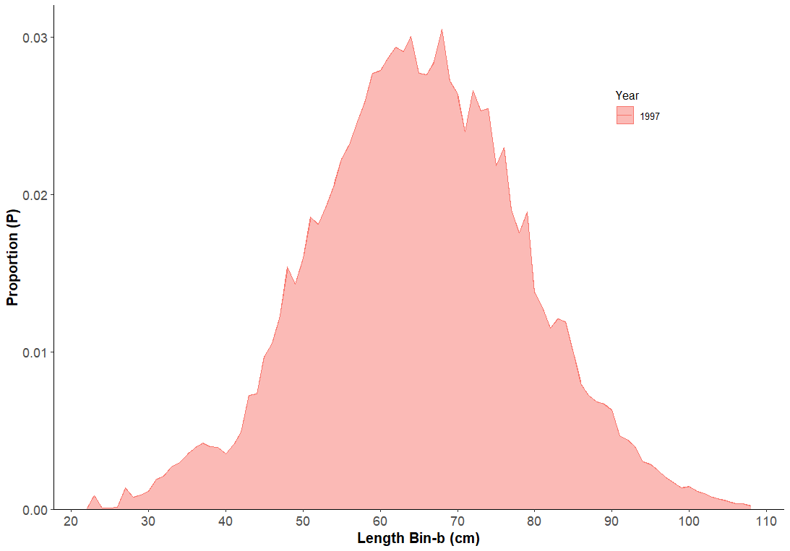
Example: Length Distribution of EBS Pcod
475,000 cod measured by observers in 1997
Notes:
Mention this is usually characterized in a stock assessment with a MULTINOMIAL DISTRIBUTION

Slide 4
Goal: Transfer principles from Survey ISS to Fishery ISS
Survey ISS uses non-parametric bootstrapping to calculate a representative ISS for use in stock assessments
Principle 1: bootstrap according to sampling structure
Principle 2: expand relative to CPUE

Slide 5
Fishery ISS Challenge
Composition data comes from observers, which complicates the transferability of principles:
Principle 1 challenge: sampling structure is more complicated
Principle 2 challenge: expansion cannot use CPUE

Slide 6
Bootstrapping for multinomial sample size
We have a (huge) sample size that has led to an observed distribution of fish lengths/ages for a year. If we assume the distribution is multinomial, what is the sample size that sufficiently characterizes that multinomial?
M&I1997: Iteratively bootstrap resample from the observed distribution to calculate a variance ratio based on an assumption of normality.
This gives us a sample size:
Notes:
I'm going to give some background on the underlying theory behind bootstrapping for sample size

Slide 7
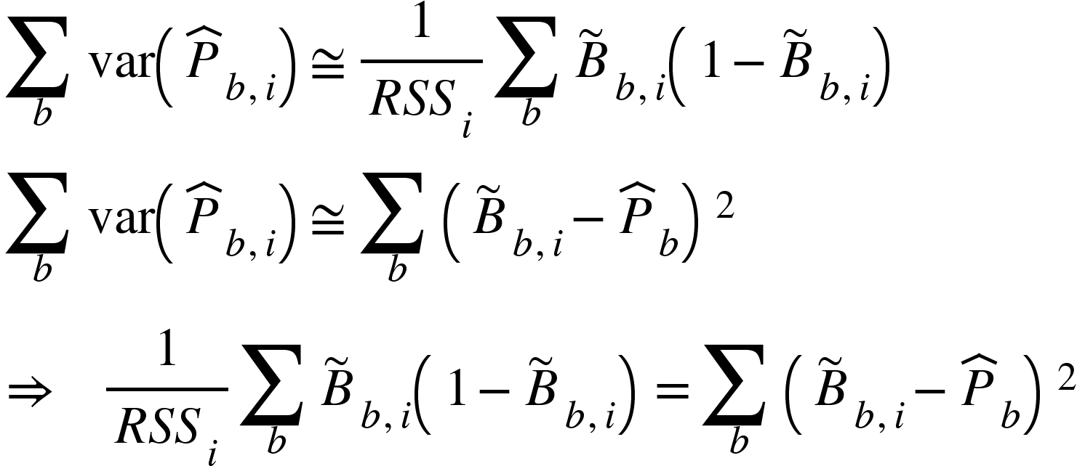
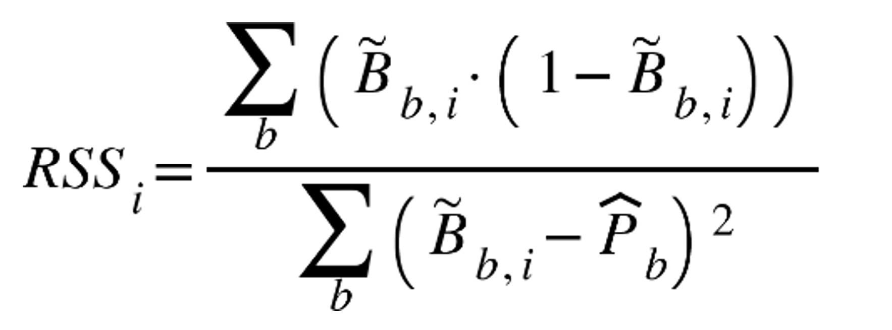
Realized Sample Size (RSS)
Multinomial variance
Normal approximation of variance
KEY:
Observed proportion – P
Bootstrapped proportion – B
Length bin – b
Iteration – i
RSS sources: McAllister and Ianelli 1997.; Stewart and Hamel 2014.; Hulson et. al. 2023.

Slide 8
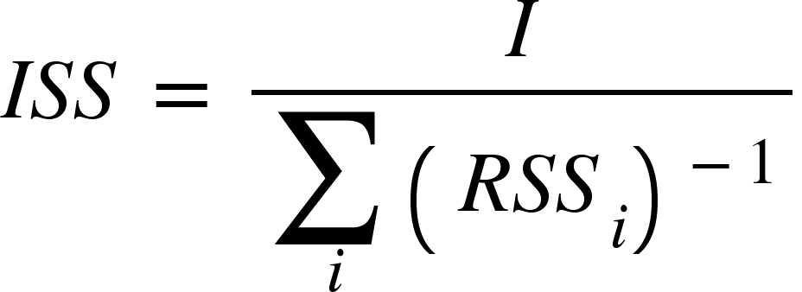
Input Sample Size
Need to get rid of the i
Take the harmonic mean:
ISS sources: Stewart and Hamel 2014.; Hulson et. al. 2023.

Slide 9
But how to get B?
Remember, B is a bootstrapped replicate of the observed proportion-at-length
Solution: Modify principles of survey ISS for fishery ISS:
Principle 1
Principle 2
Expand based on numbers of fish instead of CPUE
(e.g., numbers of fish in a haul, area, gear, month category)
Bootstrap resample at randomized observer sampling unit levels
ISS

Slide 10
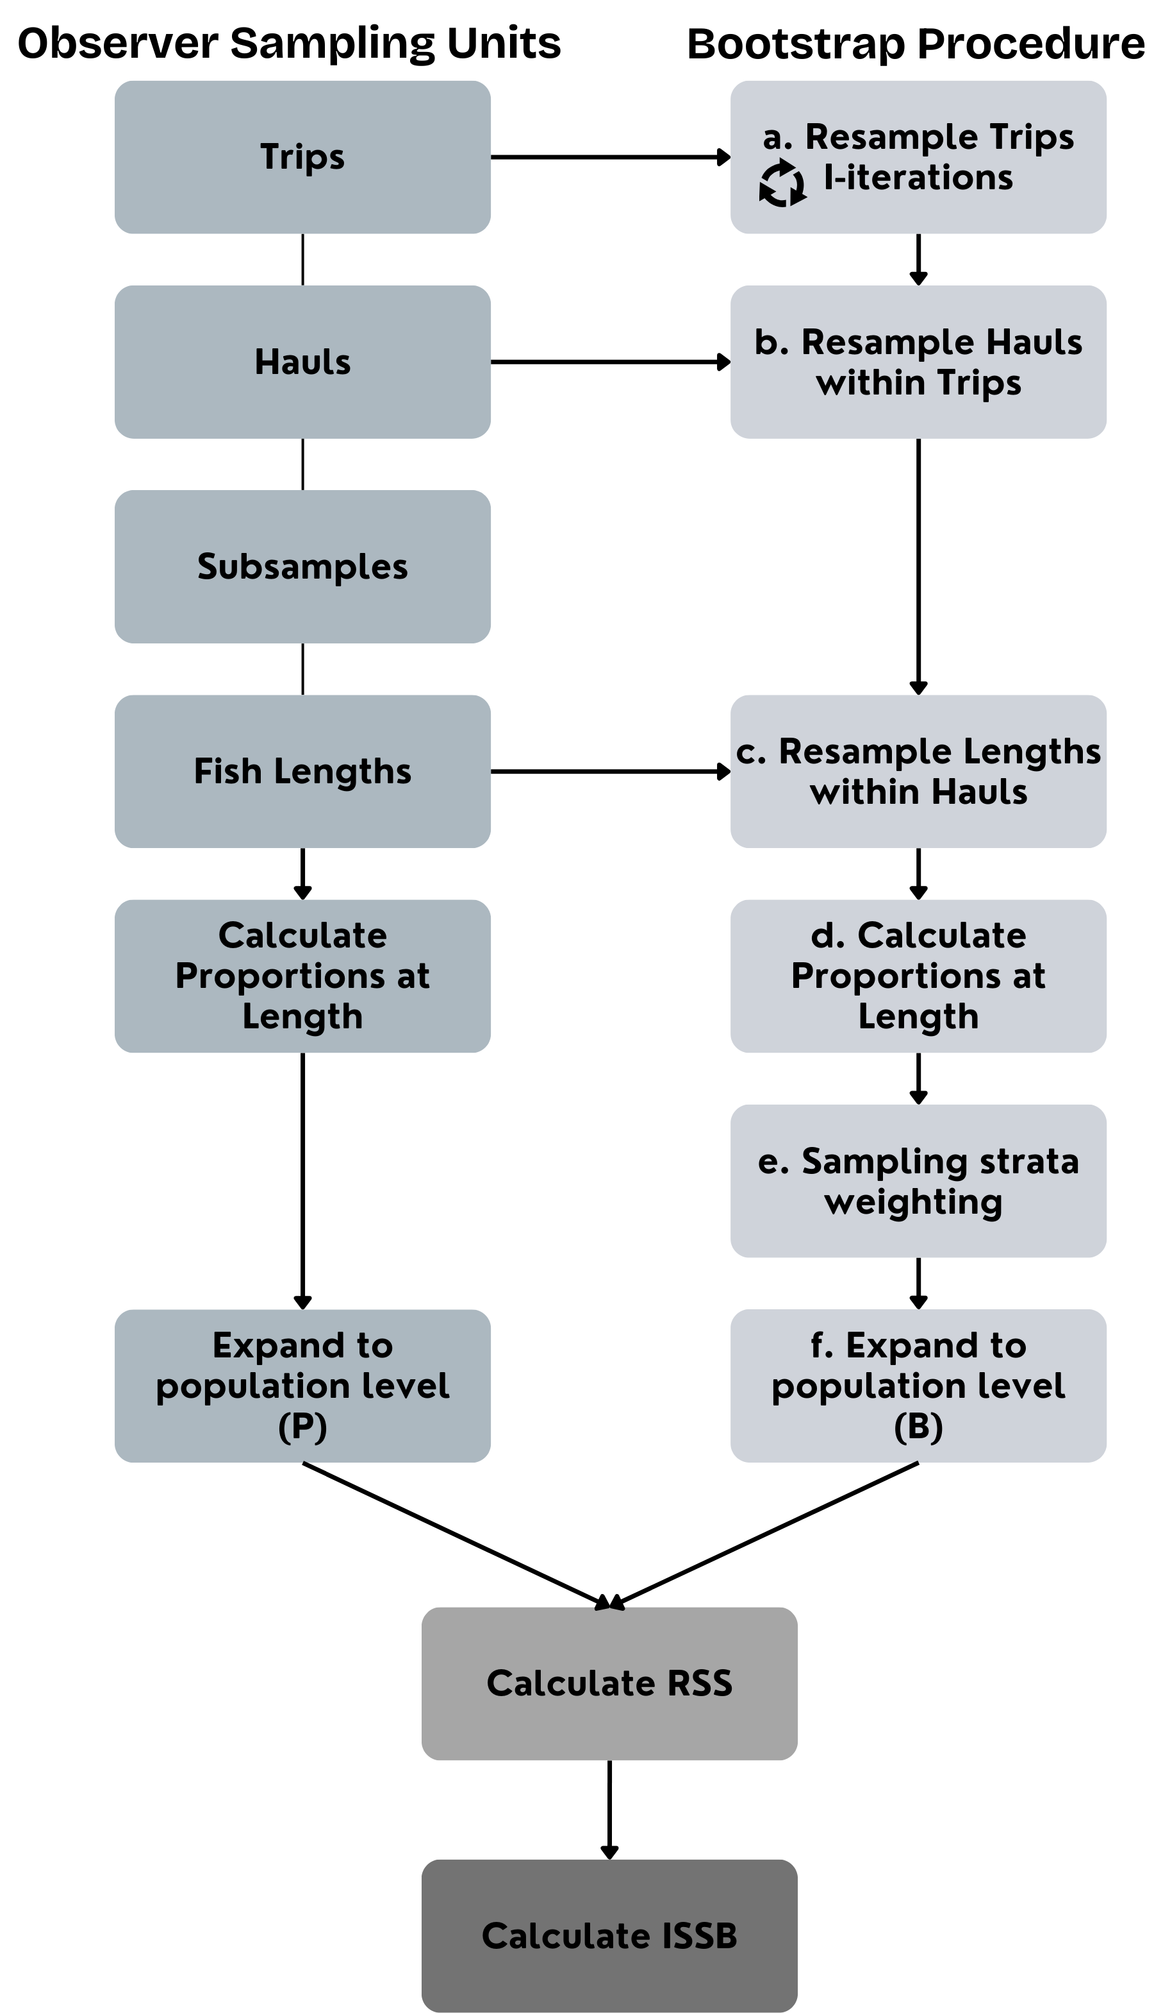
Bootstrap framework
Incorporates observer sampling design
Incorporates biologically-based expansion
Package in development:
https://github.com/Brett-Stacy/baseISS

Slide 11
Trips
Trips are the primary sampling unit
Selected randomly (unless full coverage)
Resampled Trips
Resampled with replacement
Full vector length
~500 iterations

Slide 12
Hauls
Secondary sampling unit
Resampled Hauls
Resample once from within each set of iterated trips

Slide 13
Subsamples
E.g., 3 buckets of cod from random locations in a haul dump
Not in the data set

Slide 14
Lengths
Last sampling unit
Resampled Lengths
Resample once from within each set of iterated hauls

Slide 15
Calculate proportions-at-length
Get proportions for original and each resampled set of lengths
At the haul level

Slide 16
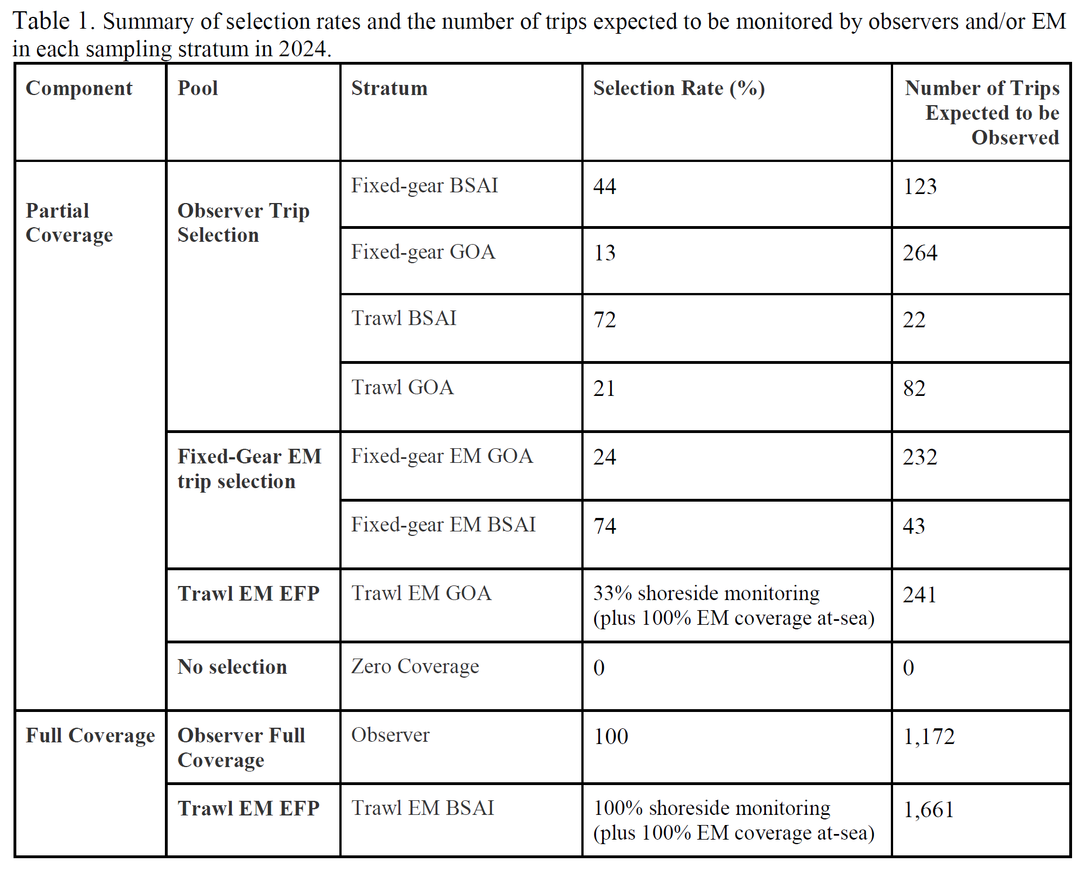
Sampling strata weighting
Apply a weighting factor dependent on the number of fish in the sampling strata the samples came from
Source: 2024 Annual Deployment Plan for Observers and Electronic Monitoring in the Groundfish and Halibut Fisheries off Alaska

Slide 17
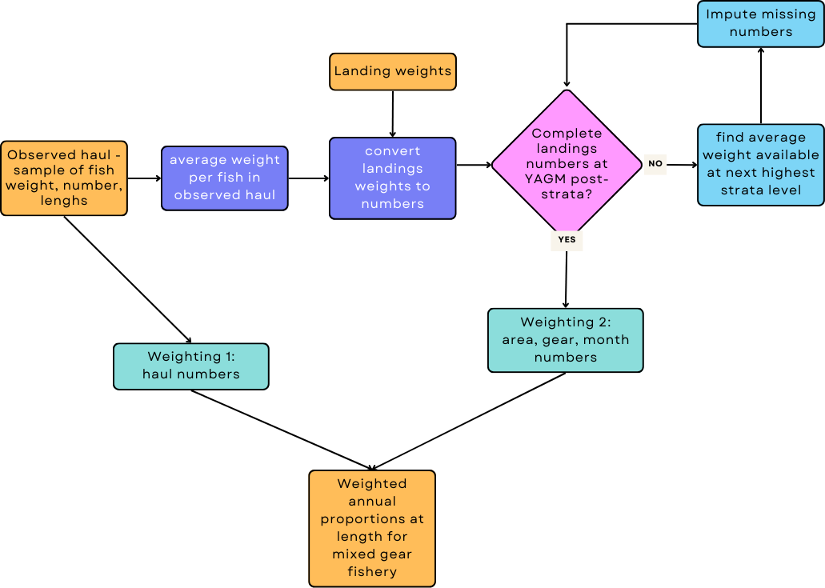
Expand to population level
Expand the original and each iterated resample proportions-at-length from the haul level to the population level

Slide 18
Calculate ISS
Plug into variance ratio equation for RSS and take the harmonic mean for ISS
Result: One number for every year that represents sample size for each year’s fishery proportions-at-length vector, expanded to the population level

Slide 19
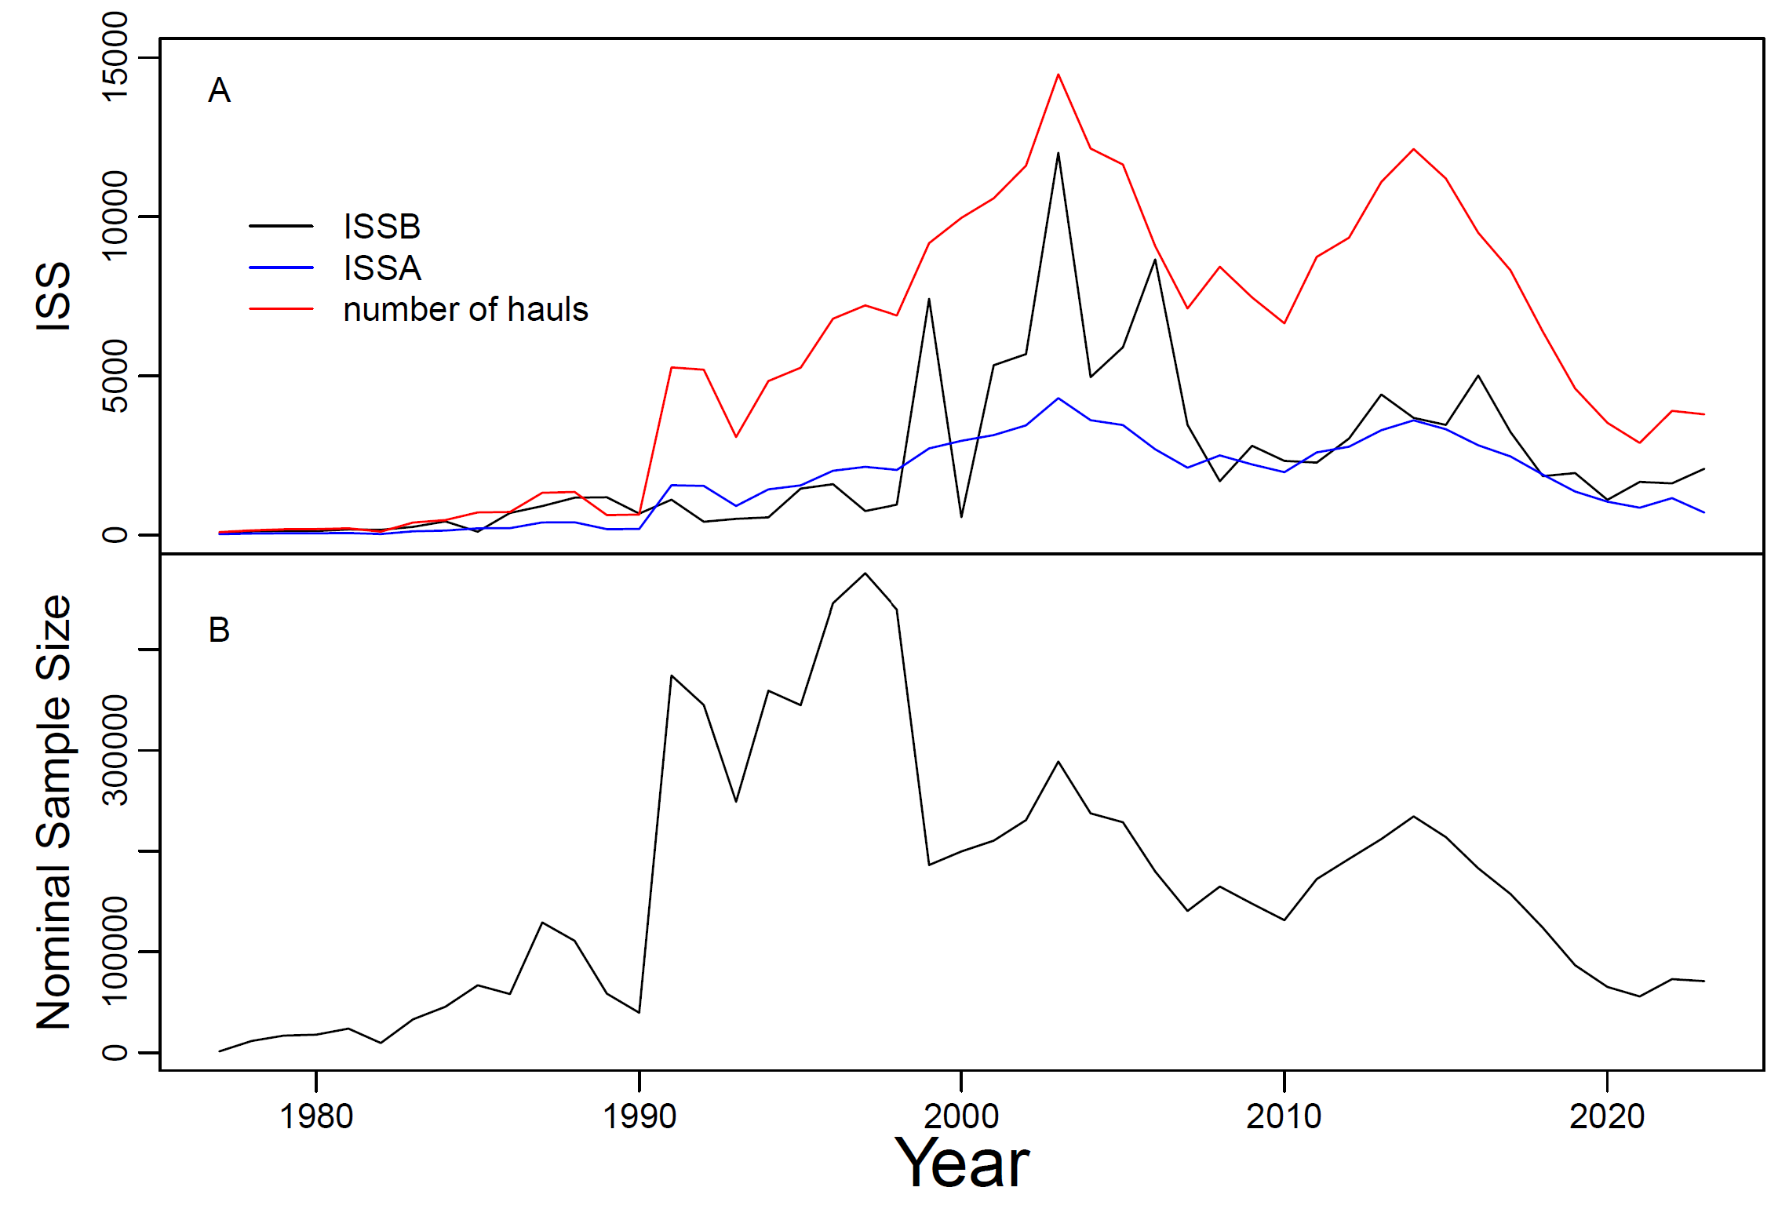
Results

Slide 20
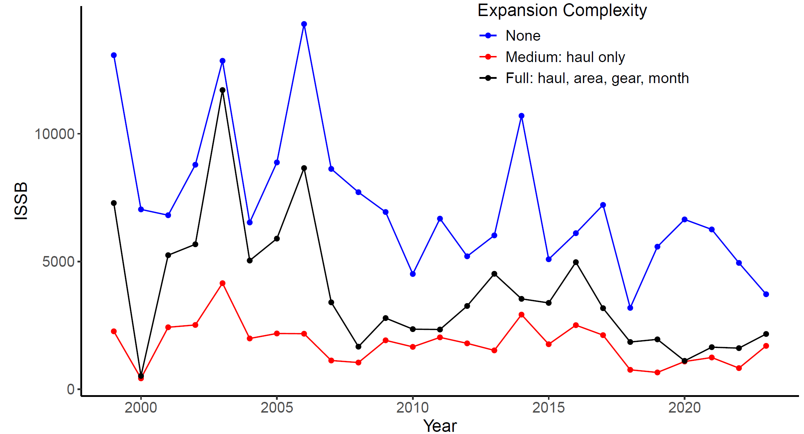
Expansion sensitivity

Slide 21
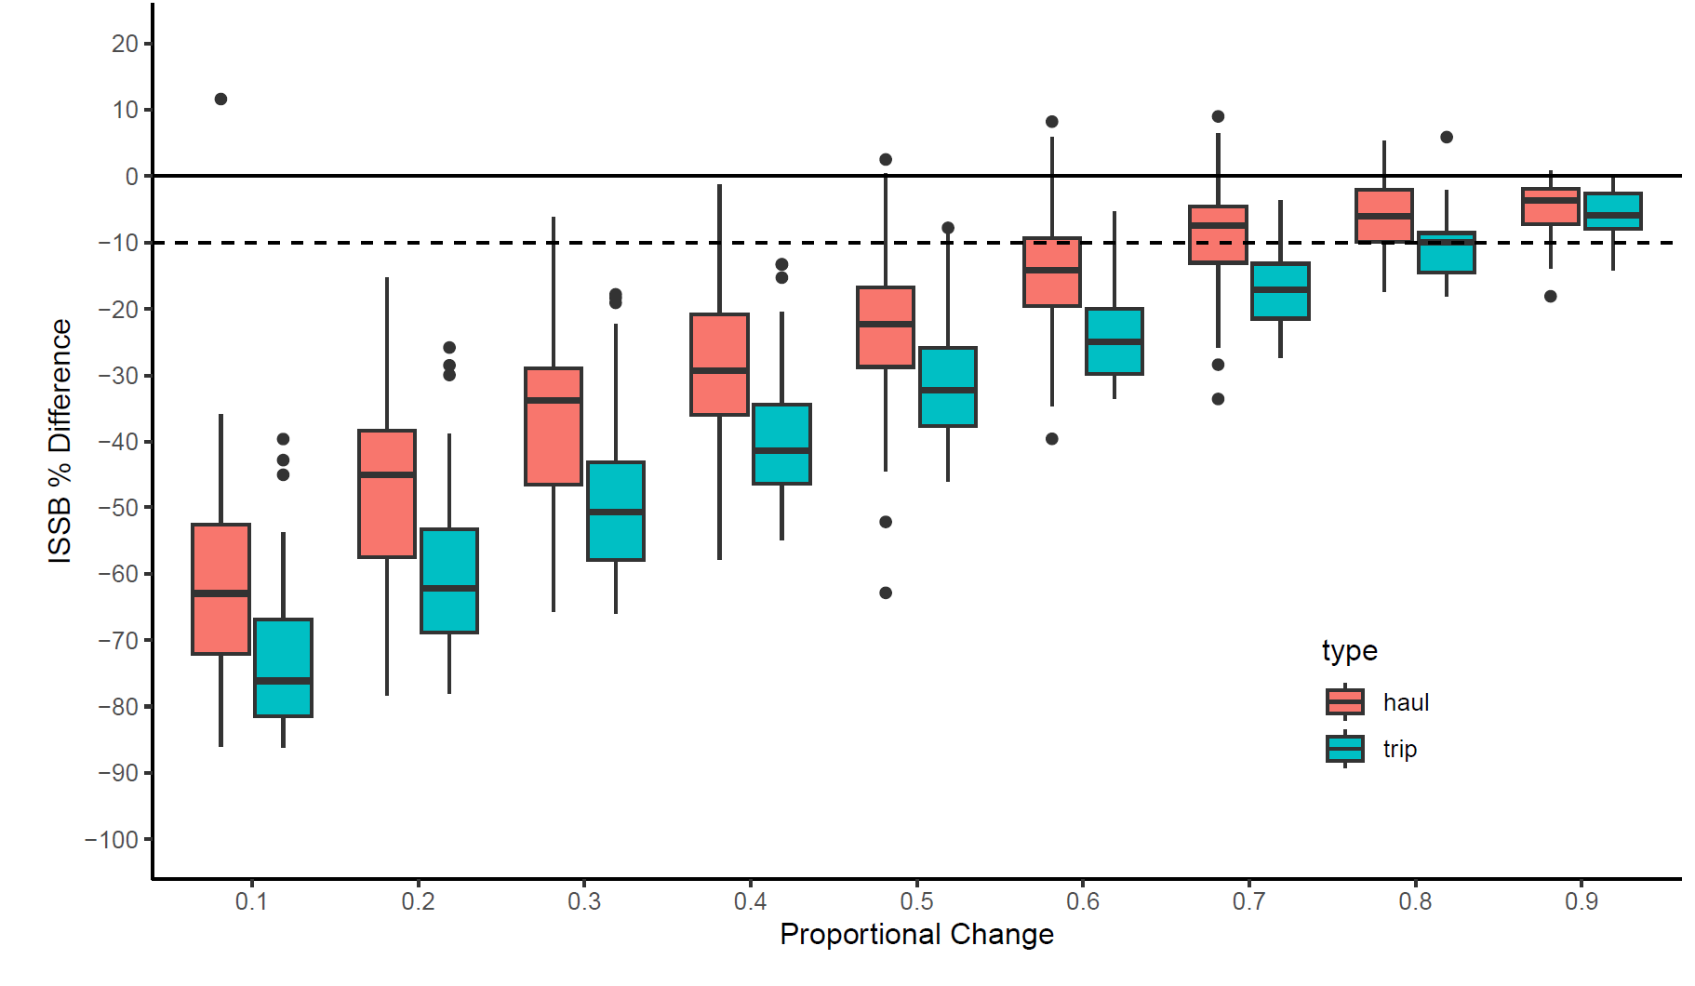
Sampling effort sensitivity: # trips or hauls

Slide 22
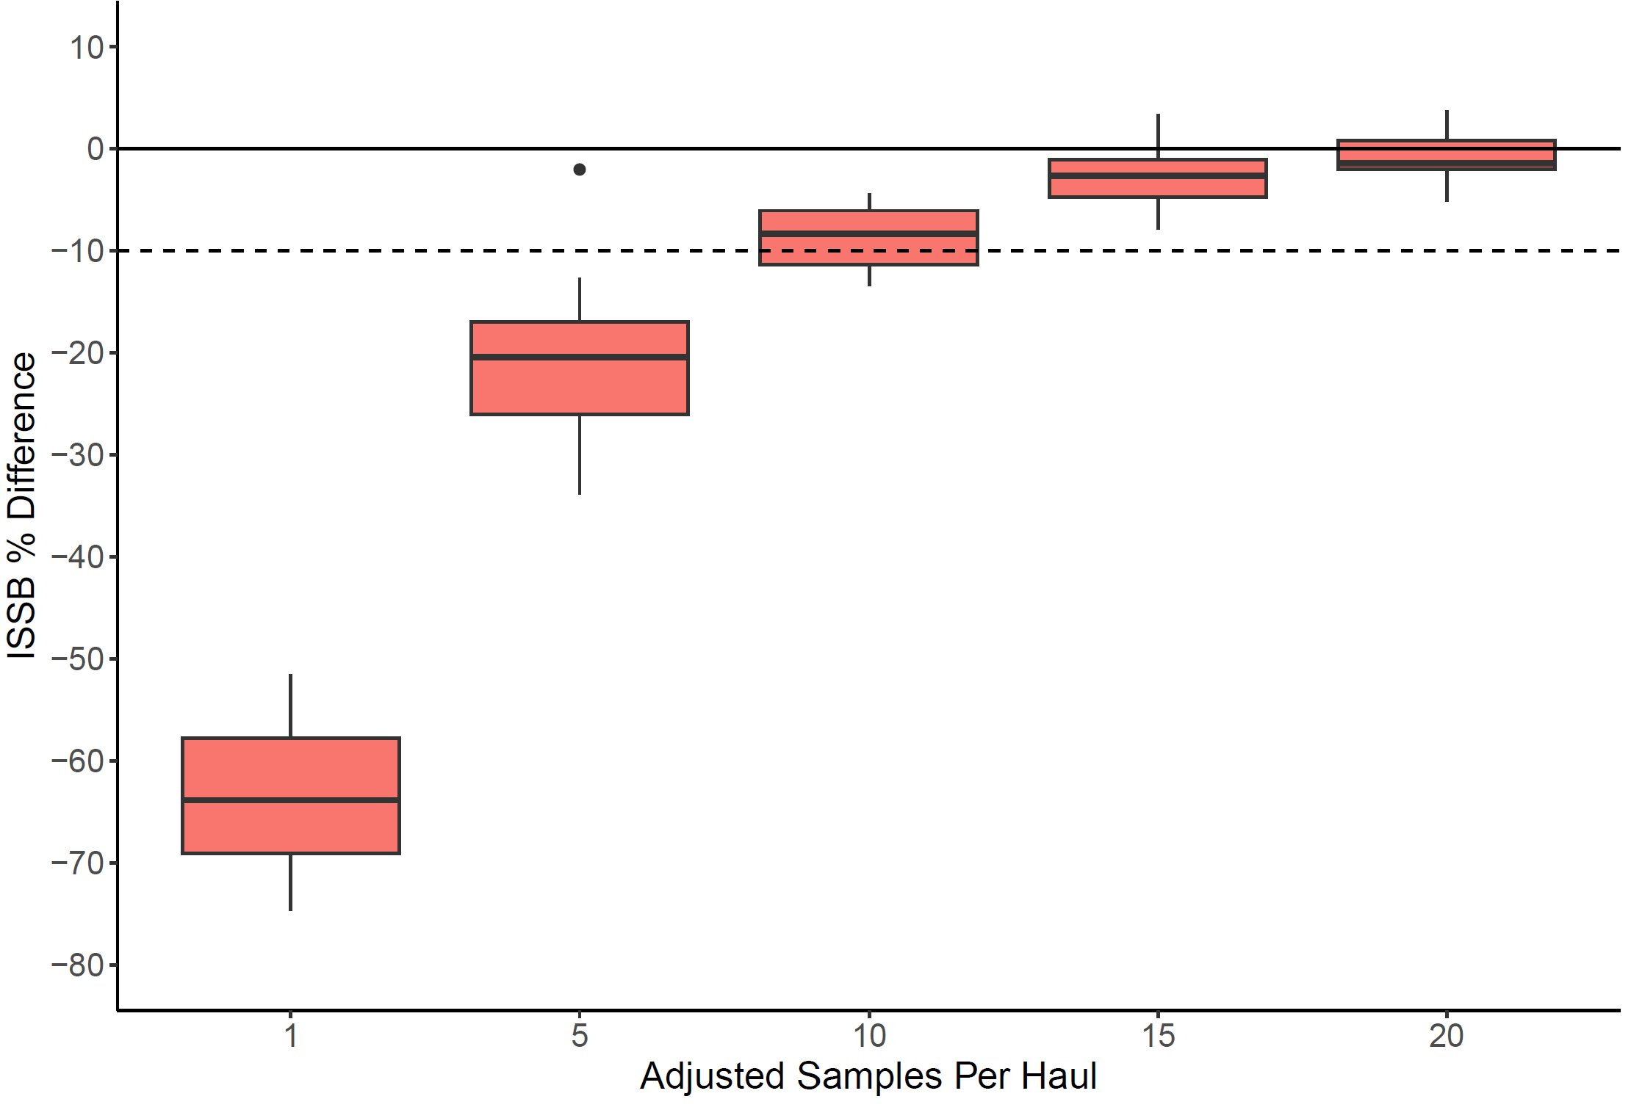
Sampling effort sensitivity: sampling rate

Slide 23
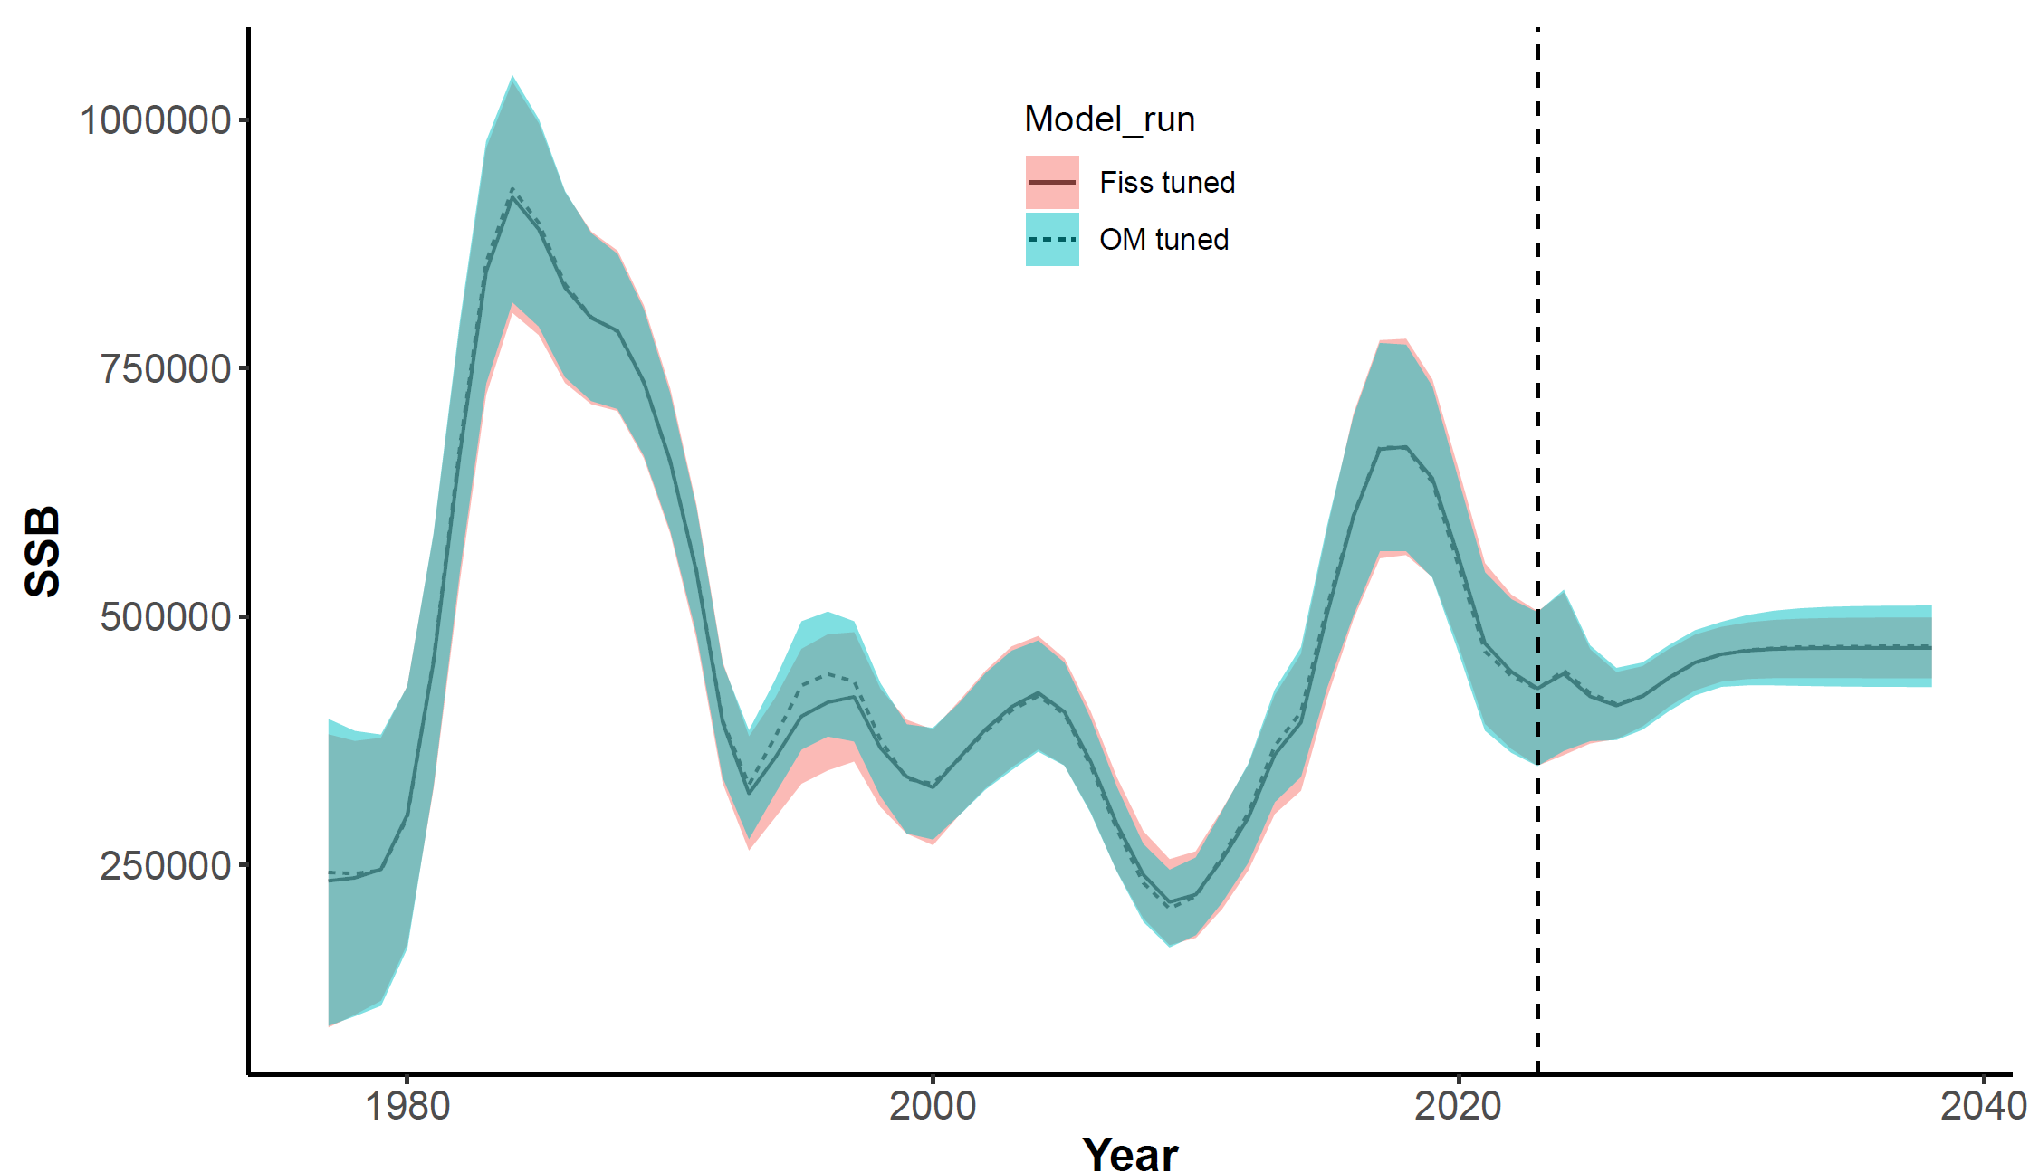
EBS Pcod stock assessment impact

Slide 24
Conclusions
Our bootstrap method transfers the principles of survey ISS
Sampling structure
Expand
Decreasing trips would sacrifice more precision than decreasing hauls
Decreasing haul sampling rate from 20 to 10 would result in ~10% loss of precision
Expansion choice is important
No impact on current estimates of SSB, some impact on projected uncertainty

